Slide 1
LEAD: FROM CONFLICT TO RESOLUTION
MAPETS Encore Presidents
February 2025

Slide 2
A state of disagreement or argument between people, groups, or countries
A situation in which you must choose between two or more needs or influences
A disagreement in which the parties involved perceive a threat to their needs, interests, or concerns
Definitions of conflict
  Other words or names
  Dispute
  Disagreement
  Competition
  Controversy
Notes:
Let’s look at the different definitions of conflict. Conflict can be understood as a state of disagreement or argument between people, groups, or even countries. It's also seen as a situation where someone has to choose between two or more needs or influences. Additionally, conflict involves a disagreement where the parties feel their needs, interests, or concerns are threatened. We often use terms like dispute, disagreement, competition, and controversy to describe conflict.

Slide 3
What are some Common causes of conflict?
Poor communication and misunderstandings
Unclear expectations
Real or perceived unfairness
Manipulative behavior
Harassment or bullying
Notes:
What are some common causes of conflict?
Conflicts often arise from differences in values, goals, or perspectives, as well as miscommunication or misunderstandings. Competing interests, limited resources, and unmet expectations can also contribute to disputes. Recognizing these root causes is the first step toward resolving conflicts effectively and maintaining positive relationships.

Slide 4
What is the difference between conflict management and conflict resolution?

Slide 5
Conflict resolution seeks solutions
to the problem, not just ways to deal with it.
Notes:
Resolving conflict involves addressing and eliminating underlying issues for a long-term solution, while managing conflict focuses on controlling negative effects without necessarily resolving the root cause. Both aim to maintain harmony and productivity, but resolving seeks a permanent fix, whereas managing maintains functionality despite ongoing issues.

Slide 6
Conflict is not
always negative!
Notes:
We often think of conflict as negative, especially if it made us feel uncomfortable or it becomes tense or violent.
But conflict can be positive. Debates, brainstorms, and competitions can lead us to better ideas and better outcomes.

Slide 7
Accommodating
Avoiding
Collaborating
Competing
Compromising
What is your Style?
Notes:
Understanding your conflict management style is crucial for navigating disagreements effectively. Whether you tend to avoid conflict, accommodate others, compete for your viewpoint, compromise, or collaborate, recognizing your default approach can help you adapt to different situations. Knowing your style allows you to leverage your strengths and address any weaknesses, fostering more constructive and empathetic interactions. By being aware of how you handle conflict, you can develop strategies to resolve disputes more effectively and maintain positive relationships.

Slide 8
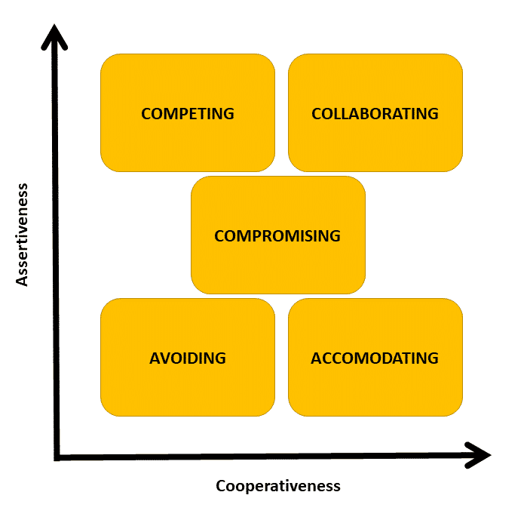
Accommodating is unassertive and cooperative. The person neglects their own concerns to satisfy the concerns of the other person.
Notes:
Conflict management is how people handle conflict.
The goal of conflict management is to reduce the negative aspects of conflict and use the positive aspects to benefit a relationship or an organization.
In an ideal world, we would collaborate to resolve every conflict. But we don't live in an ideal world, and certain factors affect how we deal with conflict.
Someone skilled in managing and resolving conflict will be able to identify the factors involved in a situation and know which style of conflict management to use to resolve it effectively.

Slide 9
Avoiding is unassertive and uncooperative. The person pursues neither their own concerns nor those of others. They simply don't deal with the conflict.
Notes:
Conflict management is how people handle conflict.
The goal of conflict management is to reduce the negative aspects of conflict and use the positive aspects to benefit a relationship or an organization.
In an ideal world, we would collaborate to resolve every conflict. But we don't live in an ideal world, and certain factors affect how we deal with conflict.
Someone skilled in managing and resolving conflict will be able to identify the factors involved in a situation and know which style of conflict management to use to resolve it effectively.

Slide 10
Collaborating is assertive and cooperative. The parties attempt to work together to find a solution that satisfies everyone's concerns.
Notes:
Conflict management is how people handle conflict.
The goal of conflict management is to reduce the negative aspects of conflict and use the positive aspects to benefit a relationship or an organization.
In an ideal world, we would collaborate to resolve every conflict. But we don't live in an ideal world, and certain factors affect how we deal with conflict.
Someone skilled in managing and resolving conflict will be able to identify the factors involved in a situation and know which style of conflict management to use to resolve it effectively.

Slide 11
Competing is assertive and uncooperative. A person pursues their own concerns without regard for others' concerns. The person may use their position of power to get their way.
Notes:
Conflict management is how people handle conflict.
The goal of conflict management is to reduce the negative aspects of conflict and use the positive aspects to benefit a relationship or an organization.
In an ideal world, we would collaborate to resolve every conflict. But we don't live in an ideal world, and certain factors affect how we deal with conflict.
Someone skilled in managing and resolving conflict will be able to identify the factors involved in a situation and know which style of conflict management to use to resolve it effectively.

Slide 12
Compromising is moderate in both assertiveness and cooperativeness. The objective is to find some mutually acceptable solution that partially satisfies all parties.
Notes:
Conflict management is how people handle conflict.
The goal of conflict management is to reduce the negative aspects of conflict and use the positive aspects to benefit a relationship or an organization.
In an ideal world, we would collaborate to resolve every conflict. But we don't live in an ideal world, and certain factors affect how we deal with conflict.
Someone skilled in managing and resolving conflict will be able to identify the factors involved in a situation and know which style of conflict management to use to resolve it effectively.

Slide 13
Self Assessment & reflection

Slide 14
“Rotary is committed to maintaining an environment that is free of harassment.”
Article 26.120
Notes:
Rotary take harassment seriously. If you think a conflict in Rotary involves harassment or bullying, review our policy for preventing and addressing adult harassment and follow the steps for reporting the issue, found on My.Rotary.Org

Slide 15
QUESTIONS
Notes:
Keep thinking about different conflict management styles and decide strategically about which style to use. You may need to adopt a style that's not natural to you to achieve the best possible outcome. Be aware of your biases and underlying interests when you deal with conflict. And don't be afraid to seek out a mediator if you need help coming to a resolution.

